Slide 1
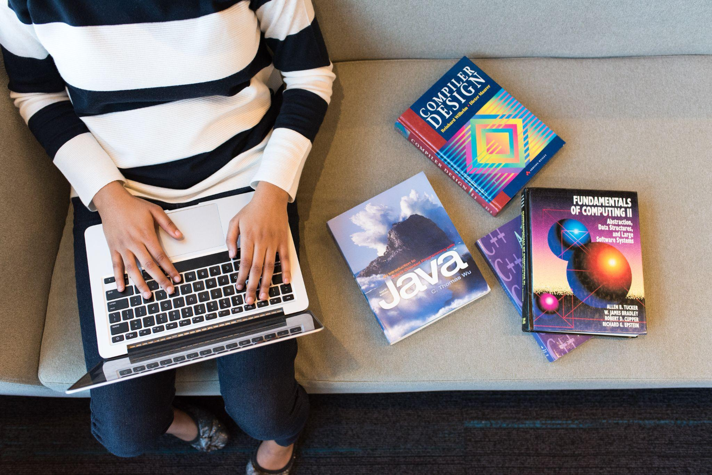
Embedded Ethics: Disability and
Software Accessibility
Module 1
Notes:
Licensed by the University of Toronto Embedded Ethics Education Initiative, Lindsey Shorser, Jonathan Calver and Paul Gries under the Attribution-NonCommercial-ShareAlike 4.0 International license. To view a copy of this license, visit https://creativecommons.org/licenses/by-nc-sa/4.0/.
Photo by Vitaly Vlasov from Pexels (https://www.pexels.com/photo/person-pointing-numeric-print-1342460/)
Photo by Charl Durand from Pexels (https://www.pexels.com/photo/the-thinker-statue-in-rodin-museum-france-6486112/)

Slide 2
One crucial set of users whose needs may differ from the average user are those with disabilities.
The WHO estimates that 15% of users have disabilities
Notes:
We can talk about the barriers themselves, how we talk about the people matters too.

Slide 3
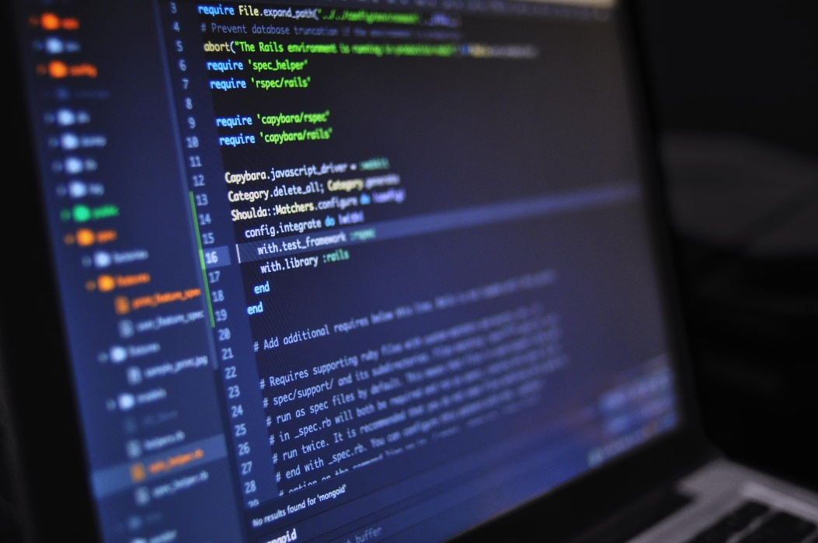
Case Study: Night mode
By giving the user the option to use Night Mode or Dark Theme, does this eliminate any barriers for users?
If so, which barriers? Who benefits from this?
If not, why else might it be offered?
Notes:
Discuss general reasons to like this feature and the overlap between people who need it vs people who might still like it anyway (specific / general to groups)
Image Source: Luis Gomes (https://www.pexels.com/photo/close-up-photo-of-programming-of-codes-546819/)

Slide 4
The concepts we use influence how we talk, act and design.
Notes:
Ask audience about object-oriented programming. (Object-oriented programming is a way of conceptualizing programming that changes how one creates programs)

Slide 5
Examples of disabilities:
Paraplegia (paralysis of lower limbs)
Deafness
Blindness
Mental illness
Speech impairment

Slide 6
What do disabilities have in common with each other?
Wasserman et al 2006: a disability is a physical or mental impairment that is associated with a personal or social limitation on the activities one can perform.
Physical or mental impairment
Personal / social limitation
Question: why does disability involve both of these?
Notes:
Test: what would happen if you took one away? Would it still be a disability? Intuitively not…

Slide 7
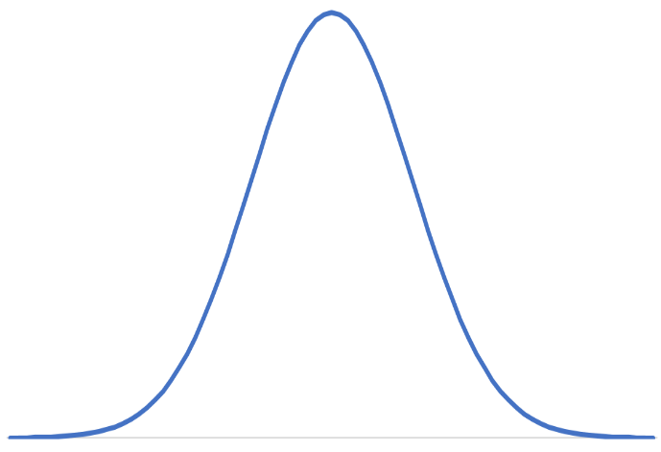
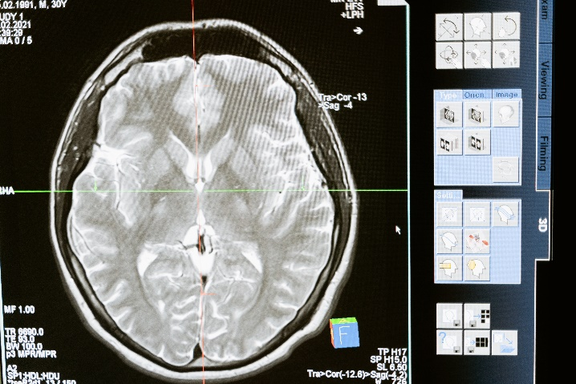
Physical or mental impairment
Biological (based on a theory of human function)
Statistical (based on deviation from some defined average)
Notes:
Image Source: Photo by MART PRODUCTION from Pexels (https://www.pexels.com/photo/technology-computer-head-health-7089020/)
(the graph is uncredited)

Slide 8
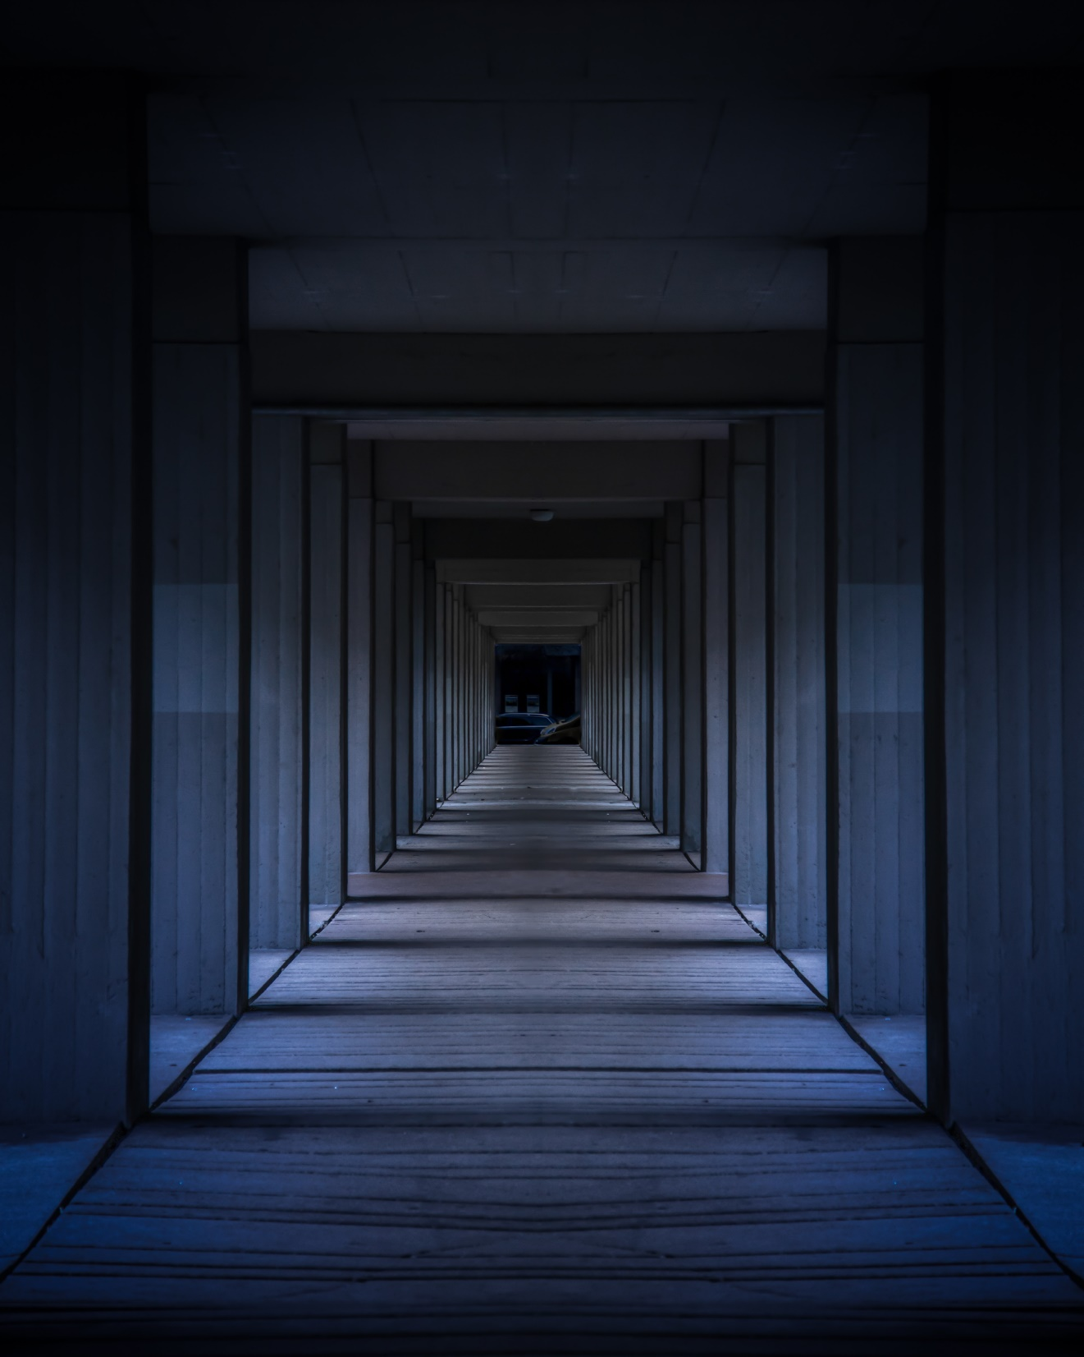
Personal / social limitation
A limitation is a limit on the set of activities that a person can perform:
Basic movements
Complex actions
Social Activities
Notes:
Photo by Anthony Macajone: https://www.pexels.com/photo/gray-concrete-building-1874636/
Stigma is also a form of limitation.

Slide 9
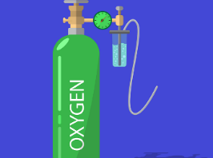
Normally we think of the “cause” of an event as another specific event that occurred before it.
Other factors are simply “background conditions” - required for the event to happen, but not part of the “cause”
Lightning storm
The forest fire
causes
Availability of oxygen for the fire
Notes:
Image 1 Source: Photo by Tanya Gorelova from Pexels (https://www.pexels.com/photo/lightning-strike-on-forest-during-night-time-3933949/)
Image 2 Source: https://www.pexels.com/photo/forest-on-fire-51951/
Image 3 Source: Image by Shafin Al Asad Protic from Pixabay (https://pixabay.com/vectors/oxygen-icu-medical-gas-cylinder-5306040/)

Slide 10
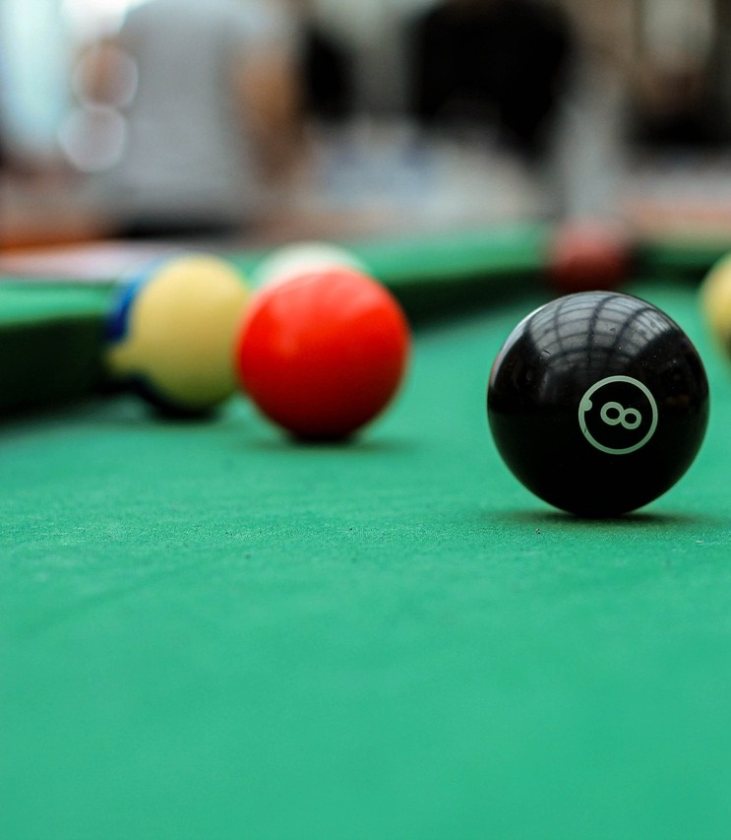
Poll 1
Event: Billiard ball #1 hits billiard ball #2, and billiard ball #2 starts moving. What do you think is best described as the “cause” of billiard ball #2 starting to move? 1) Billiard ball #1 hitting billiard ball #2 2) The lack of glue on the table Insert Link to Poll (mentimeter, google forms, etc)
Notes:
Image by mfkarabulut from Pixabay

Slide 11
Poll 2
Event: The forest fire.
What do you think is best described as the “cause” and what is the “background condition”? What is the cause? 1) The routine thunderstorm 2) The exceptionally dry summer Insert Link to Poll (mentimeter, google forms, etc)
Notes:
Image source: Guduru Ajay bhargav: https://www.pexels.com/photo/orange-fire-948270/

Slide 12
The Medical Model of disability
Physical or mental impairment
Personal / social limitation
causes
Human world
In some disabilities, the limitations are caused by the physical or mental impairment.
The human world is a background condition

Slide 13
The Social Model of disability
Human world
Personal / social limitation
causes
Physical or mental impairment
In some disabilities, the limitations are caused by the human world – whether through stigma or environmental design.
The impairment is a background condition.

Slide 14
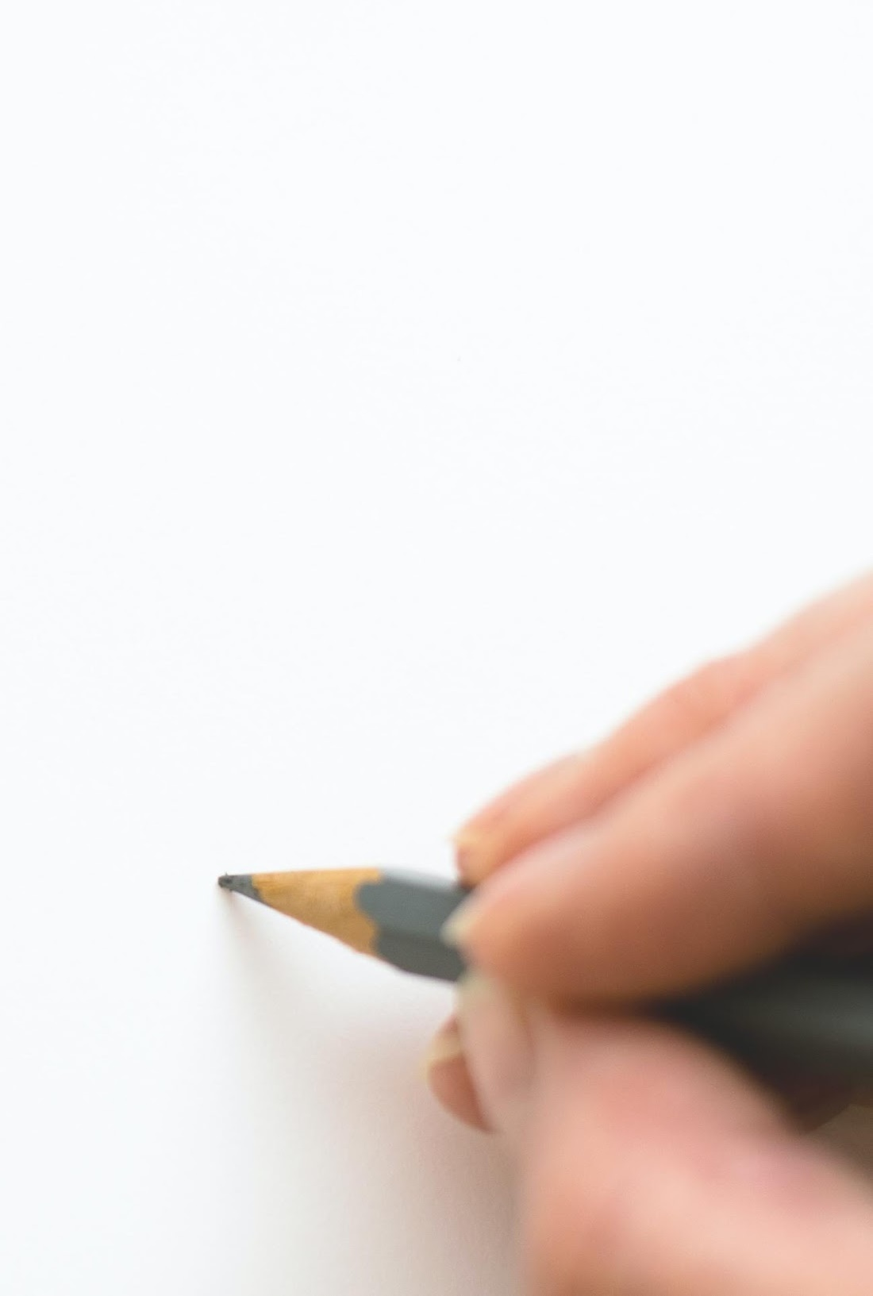
It matters how we conceptualize disability.
If we conceptualize disability through the medical model, we tend to address disability by removing the trait that causes it.
If we conceptualize disability through the social model, we tend to address disability by modifying the environment around it.
Notes:
Image source: Lum3n: https://www.pexels.com/photo/close-up-of-hand-holding-pencil-over-white-background-316466/

Slide 15
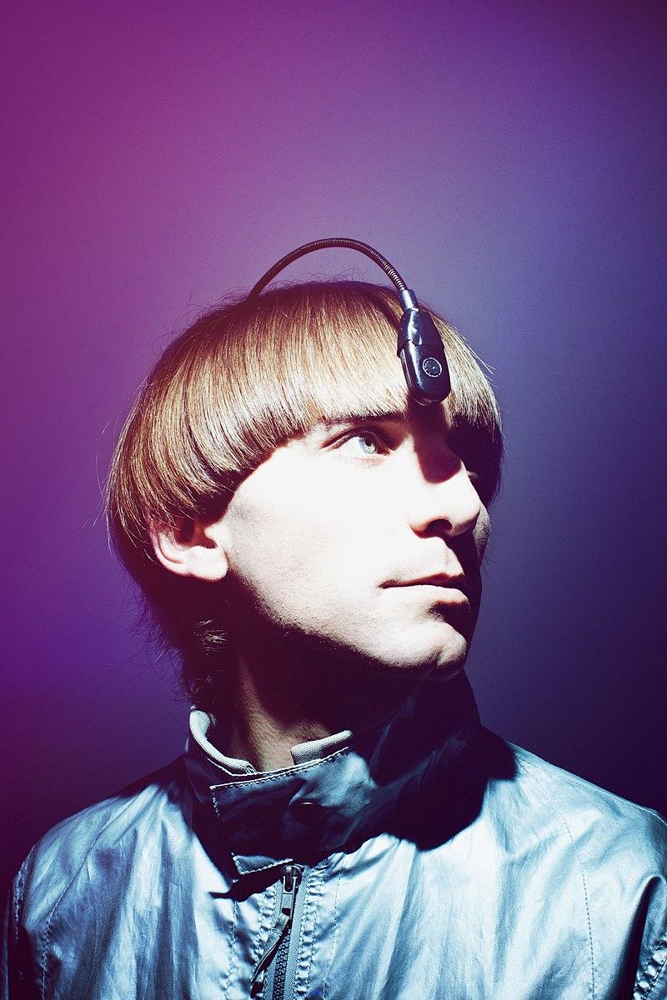
“Well, I was born with a rare visual condition called achromatopsia, which is total color blindness, so I've never seen color, and I don't know what color looks like, because I come from a grayscale world…
…But, since the age of 21, instead of seeing color, I can hear color… it's a color sensor that detects the color frequency in front of me — (Frequency sounds) — and sends this frequency to a chip installed at the back of my head, and I hear the color in front of me through the bone, through bone conduction.”
Neil Harbisson, “I Listen to Color”
(TED Talk)
Notes:
Image source: https://en.wikipedia.org/wiki/Neil_Harbisson#/media/File:World's_First_Cyborg.jpg
Neil Harbisson (Mataró, 27 July 1984) is a Catalan-born British-Irish-American^{[18]} cyborg artist and activist for transpecies rights. He is best known for being the first person in the world with an antenna implanted in his skull.^{[19]} Since 2004, international media has described him as the world's first legally recognised cyborg and as the world's first cyborg artis

Slide 16
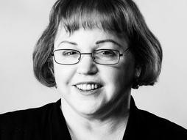
“Hearing people assume that the Deaf live in a perpetual state of wanting to hear, because they can't imagine any other way. But I've never once wished to be hearing. I just wanted to be part of a community like me.”
Rebecca Krill, “How Technology has Changed What it’s Like to be Deaf” (TED Talk)
Notes:
[Deafness as a community]
Rebecca Knill is a writer about technology and disability

Slide 17
For some impairments, and some limitations, the medical model will seem more appropriate.
For some impairments, and some limitations, the social model will seem more appropriate.
Notes:
Image source: Tima Miroshnichenko (https://www.pexels.com/photo/person-holding-a-colors-swatch-6474454/)

Slide 18
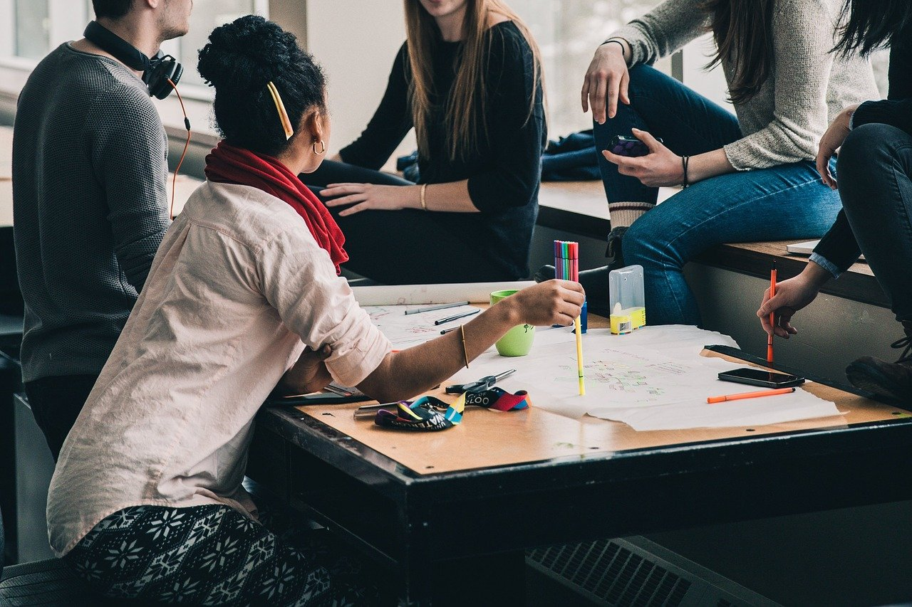
In the following, what would you say causes the limitation? Is it the impairment, or the human world?
Impairment 1: Paraplegia (paralysis of the lower limbs)
Limitation: difficulty accessing public spaces.
Impairment 2: Attention deficit disorder (ADD)
Limitation: difficulty concentrating on schoolwork.
Take five minutes: Discuss your answer with your neighbours. Do they have the same opinion as you?
Notes:
Image Source: https://pixabay.com/photos/people-girls-women-students-2557396/

Slide 19
Comparing the Medical Model and Social Model
Q: How would the medical and social model differ in their prescriptions for each disability?
 | How would the medical model address this disability? | How would the social model address this disability?
Paraplegia
Attention Deficit Disorder
Notes:
If time permits, ask them for specific computer software design related ideas.

Slide 20
Summary
The concepts we use to think about disability (and programming!) matter.
According to the medical model of disability, a physical or mental impairment causes a personal or social limitation.
According to the social model of disability, the human world causes a personal or social limitation.

Slide 21
How we imagine our users affects how we choose which features to implement in our programs.
Notes:
When we’re designing, we should consider specific sets of users who would benefit from accessibility features.
We already have principles that can help us make design decisions for the back end of our programs. Today, we are going to build up to principles that will help us decide what features to implement to make our programs more accessible.
In order to talk about accessibility we are first going to discuss disability and ways to think about disability.

Slide 22
Back to Software Design
When creating a program, we already have to consider the technical requirements for the user's software and hardware
(example: Which operating systems will run it? How much memory is required?)
From the medical model perspective, we can consider personal requirements as well
(example: How precise does their coordination have to be?)
Through the social model, we can ask ourselves: Who might need this software? What barriers to usage might they face?

Slide 23
Software and the Medical Model
Here are some examples of software that are specifically designed to be accessible to people with various diagnoses:
Braille Translation Software (example: Index BrailleApp) converts text to a document that can be printed by a Braille printer
Software that runs a simplified phone interface for people with Down Syndrome (example: Simple Smartphone)
Programs that can learn from users’ past mistakes to predict future text and suggest corrections for spelling and grammatical errors, aimed at people with dyslexia (example: Ghotit)

Slide 24
Software and the Medical Model
Here are some more examples of software that are specifically designed to be accessible to people with various diagnoses:
Sip-and-puff systems that allow a person to input information into a computer using a joystick that can be manipulated in any direction by their mouth, like a joystick, and sipping or puffing into the controller replacing clicking a mouse (example: Jouse3 for drawing or computer games, Origin instrument products for controlling a mouse, joystick, or keyboard)
Domain specific voice recognition software that allows people to create text by speaking instead of typing (example for math symbols: MathTalk)
Notes:
Typing Latex? Ugh!

Slide 25
Software and the Social Model
Here are some examples of software features that are aimed to allow programs to reach a wider audience regardless of whether or not users are identified as disabled:
Automatic Captioning for anyone who might understand better if they see the words being spoken (example: Zoom feature)
Giving the user the ability to zoom in to see the UI better, or otherwise change the size of icons and text (example: all operating systems)
Allowing "unlocking" a device using biometrics like fingerprint instead of a pass code (example: Windows 10, Mac OS)
Text-to-speech features that allow anyone to listen to a text (example: Speechify)
Dark Theme (example: IntelliJ)

Slide 26
Links to Companies
Index BrailleApp -- https://www.indexbraille.com/
Simple Smartphone -- http://simplesmartphone.com
Ghotit -- https://www.ghotit.com/
Jouse3 -- https://www.enablingtech.ca/products/jouse-3
MathTalk -- https://mathtalk.com/
Zoom -- https://zoom.us
Biometrics -- Linux, Mac, Window
https://itsfoss.com/fingerprint-login-ubuntu/
https://support.apple.com/en-ca/guide/mac-help/mchl16fbf90a/mac
https://www.computerworld.com/article/3244347/what-is-windows-hello-microsofts-biometrics-security-system-explained.html
IntelliJ -- https://www.jetbrains.com/idea/

Slide 27
Designing for Accessibility
World Wide Web Consortium on Accessibility in Web Design
Google accessibility pages for Android and web design
General Google Accessibility Guidelines
Apple Accessibility Guidelines

Slide 28
Principles of Universal Design
Principle 1: Equitable Use
Principle 2: Flexibility in Use
Principle 3: Simple and Intuitive Use
Principle 4: Perceptible Information
Principle 5: Tolerance for Error
Principle 6: Low Physical Effort
Principle 7: Size and Space for Approach and Use
Discussion Question: For each principle, does the Dark Theme option follow the principle? If so, in what way?
Notes:
go through as many as possible, prioritizing perceptible information, flexibility of use, size and space (because it’s not really a software thing)
Background Image Source: Marek Levak at Pexels (https://www.pexels.com/photo/woman-using-silver-laptop-2265488/)

Slide 29
Acknowledgements
This module was created as part of an Embedded Ethics Education Initiative (E3I), a joint project between the Department of Computer Science¹ and the Schwartz Reisman Institute for Technology and Society², University of Toronto.
Instructional Team:
Philosophy: Steve Coyne, Alexandra Gustafson
Computer Science: Lindsey Shorser, Paul Gries, Jonathan Calver
Faculty Advisors:
Diane Horton¹, David Liu¹, and Sheila McIlraith^{1,2}
Department of Computer Science
Schwartz Reisman Institute for Technology and Society
University of Toronto

Slide 30
References
Anderson-Chavarria, Melissa. 2021. “The autism predicament: models of autism and their impact on autistic identity”, Disability & Society, DOI: 10.1080/09687599.2021.1877117
Wasserman, David, Adrienne Asch, Jeffrey Blustein, and Daniel Putnam, "Disability: Definitions, Models, Experience", The Stanford Encyclopedia of Philosophy (Summer 2016 Edition), Edward N. Zalta (ed.), URL = https://plato.stanford.edu/archives/sum2016/entries/disability/

